Slide 1
Interpersonal skills:
1. 5 Minutes Presentation
2. How to read a Paper
3. How to write a paper
4. 10 tips for better teamwork

Slide 2
1. 5 minutes presentation
Importance of 5 minutes-
Indira Gandhi, Prime minister of India had a 5 minutes call with then general Sham Manek Shah that result into a whole new Country.

Slide 3


Motive
Crafting a compelling five-minute presentation requires clarity, focus, and impact.

Slide 4
Five ways to create a five minutes presentation:
Research the concept
Make slides simple.
Practice
Introduce with flair and Immediately
Tell a story

Slide 5
Research the Concept
“Research is to make what is invisible visible.” Ernest Boyer
Although your material is limited for your five-minute presentation, you will still need to do enough research to understand your topic and extract the most important concepts

Slide 6
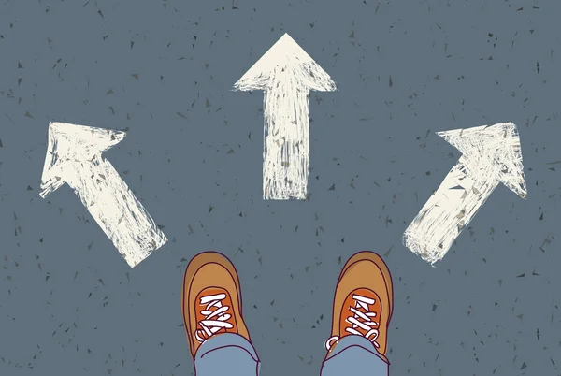
Choose to make your slides Simple.
Make your slides simple and concise.

Slide 7
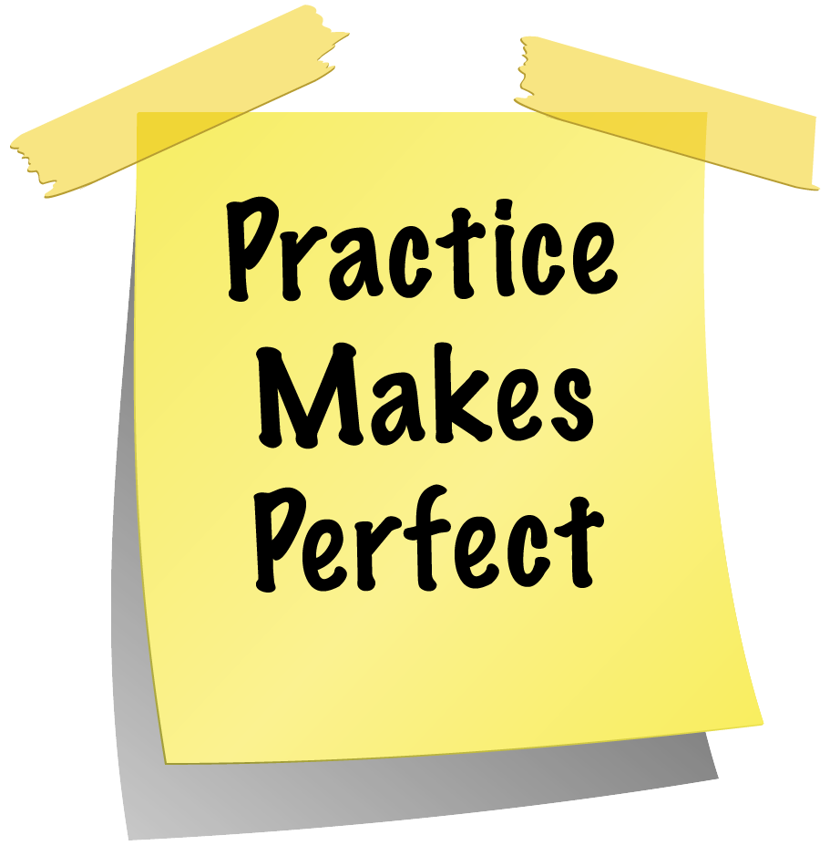

Practice
“Practice makes human perfect”
Rehearsal is critical for such a short presentation.
Practice your tone, inflections, and body language in front of the mirror.

Slide 8
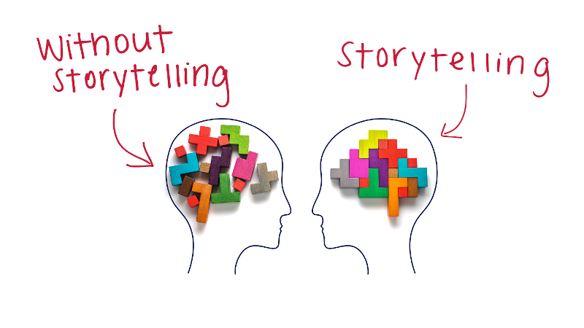
Tell a story
A memorable presentation tells a memorable story.

Slide 9


2. How to Read a paper
Your goal is to understand the scientific contributions the authors are making.

Slide 10
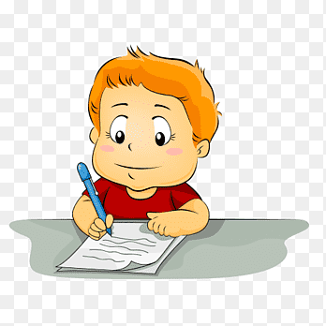
3. How to Write a paper.
There are various ways to write your assessments.
So, choose wisely.

Slide 11

Type of Paper
Essays
Presentation
Quiz
Reports

Slide 12
4. Tips for better teamwork
Choose your team wisely.
Strong commitment
Mission towards same goal.
Better Communication

Slide 13
Conclusion:
These Interpersonal skills will help to study in discipline and gain more knowledge.

Slide 14

References:
5 minutes presentation (https://www.liveabout.com/mastering-the-art-of-the-5-minute-presentation-2951697)
How to read a paper (chrome-extension://efaidnbmnnnibpcajpcglclefindmkaj/https://www.eecs.harvard.edu/~michaelm/postscripts/ReadPaper.pdf)
How to write a paper (https://www.openpolytechnic.ac.nz/current-students/study-tips-and-techniques/assignments/assignment-types/)
Tips for Teamwork (https://www.liveabout.com/tips-for-better-teamwork-1919225)

